Slide 1

RLadies-Philly R for Beginners How to download and Install R Studio
Presented by: Tess Cherlin
@alldayscientess
tess.cherlin@jefferson.edu

Slide 2
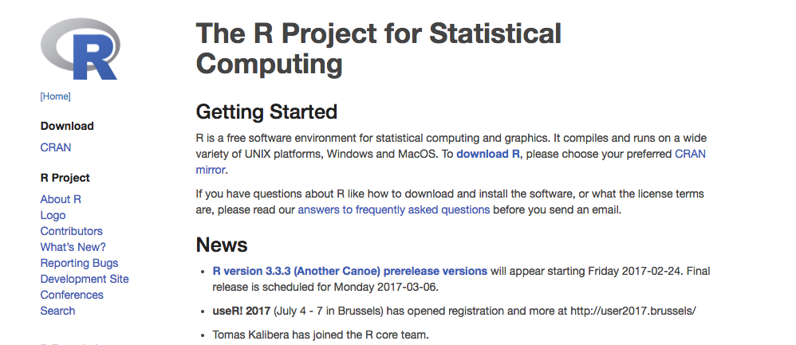
Step 1: go to R website https://www.r-project.org/

Slide 3

Step 2: Click CRAN (Comprehensive R Archive Network)

Slide 4
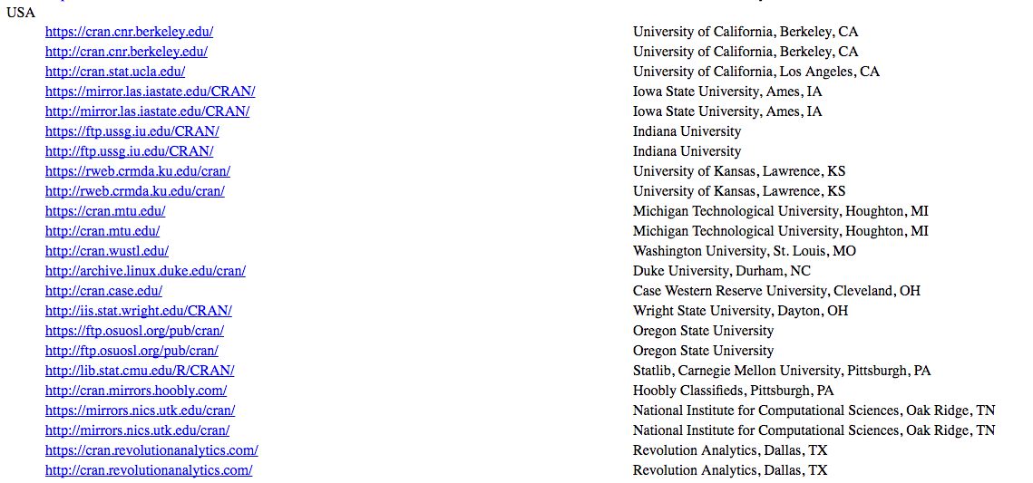
Step 3: Click on R Mirror (For speed of download)
If you’re in PA but choose the R mirror closest to you!

Slide 5
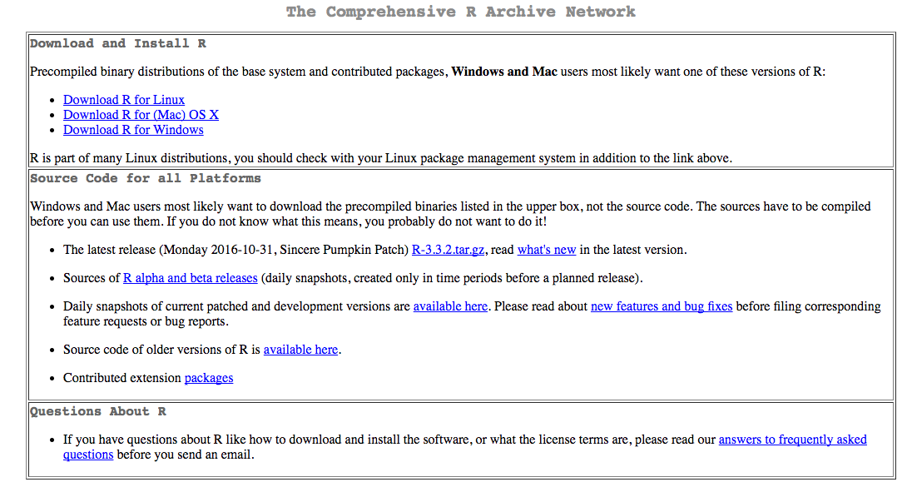
Step 4: Choose R Package for your operating system

Slide 6
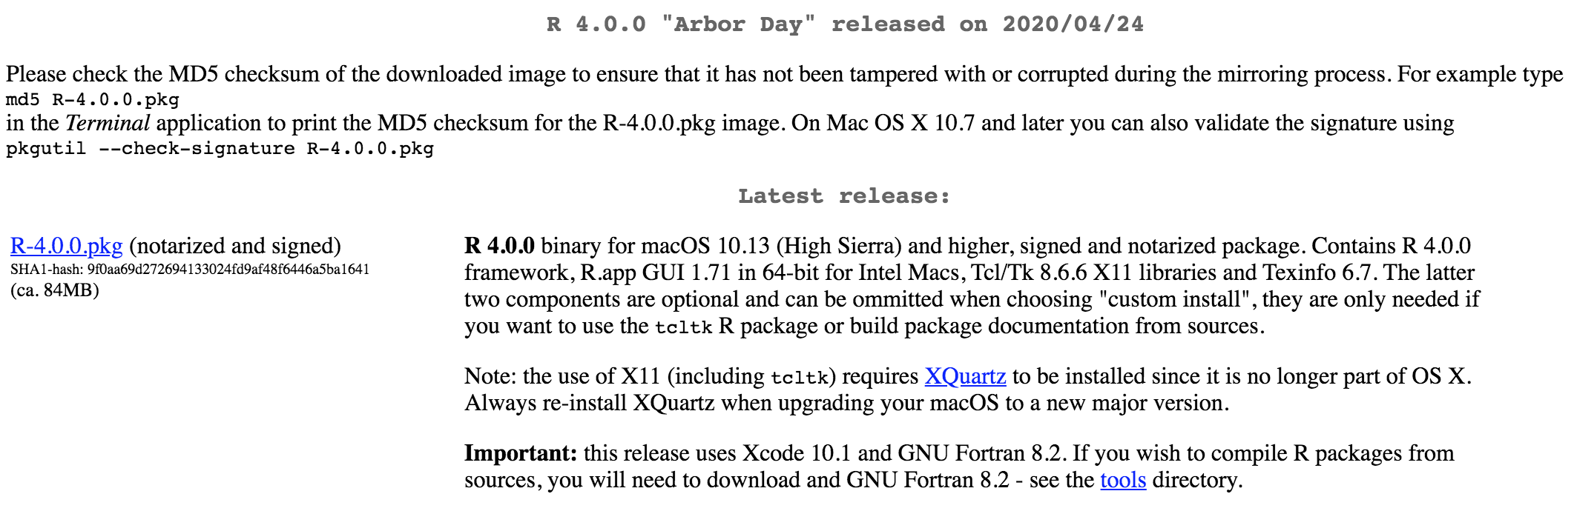
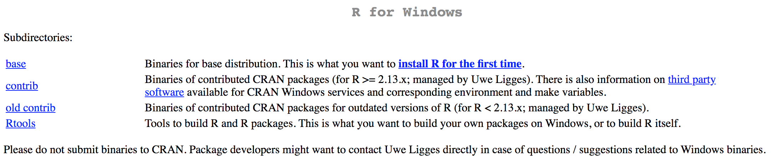
Step 5: Download/Install R
Mac 10.13
Windows

Slide 7
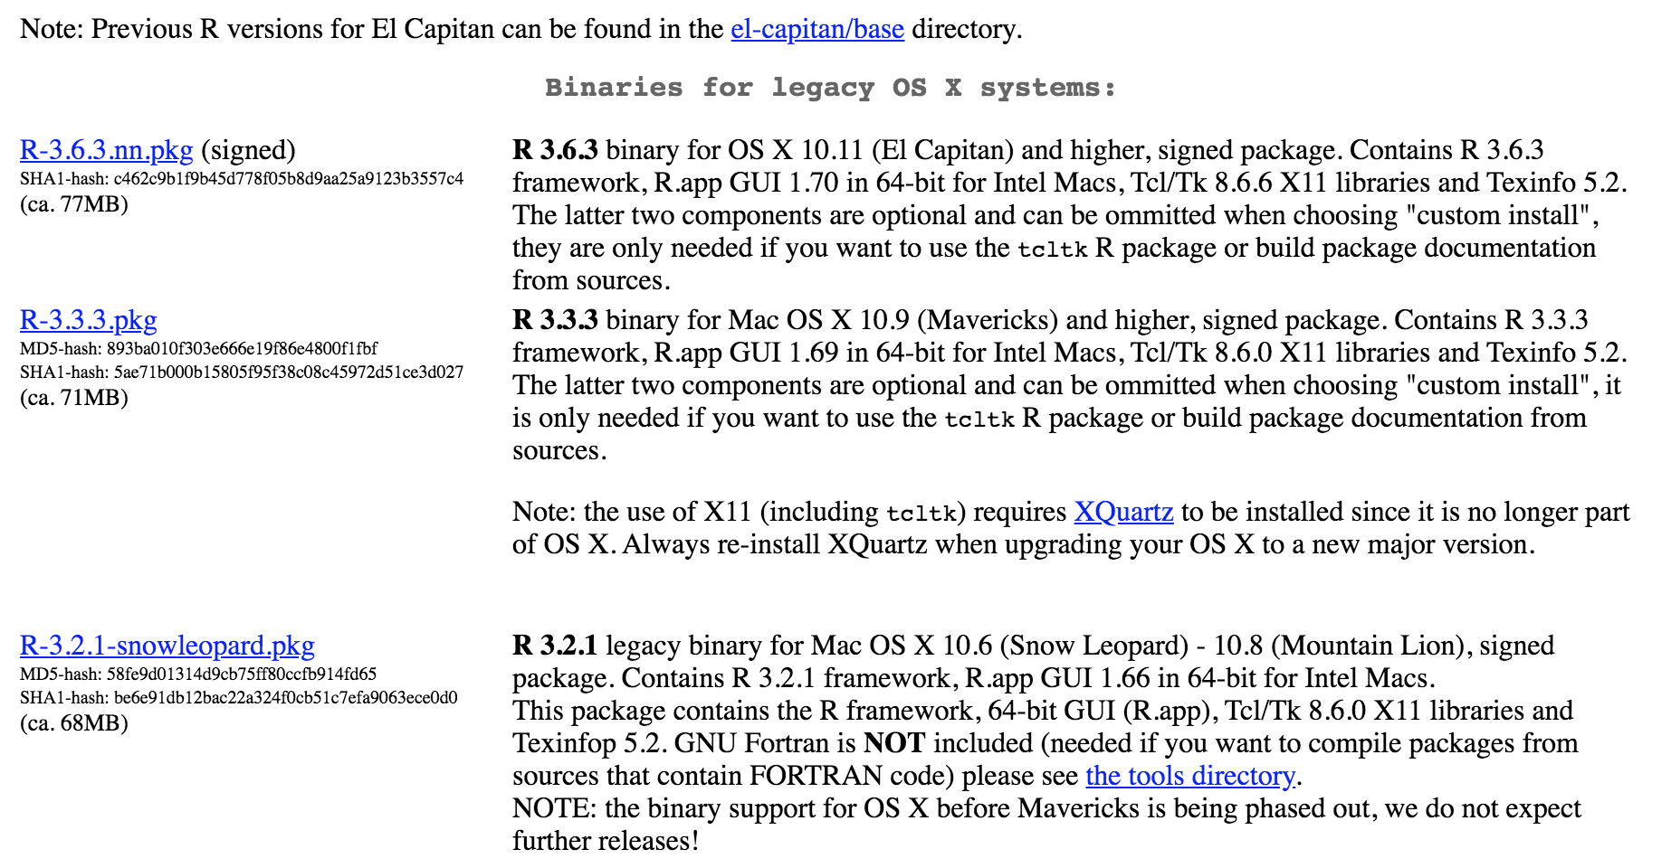
Step 5a: Older versions (Mac OS X)
Only if necessary
Choose older version of R for your OS

Slide 8
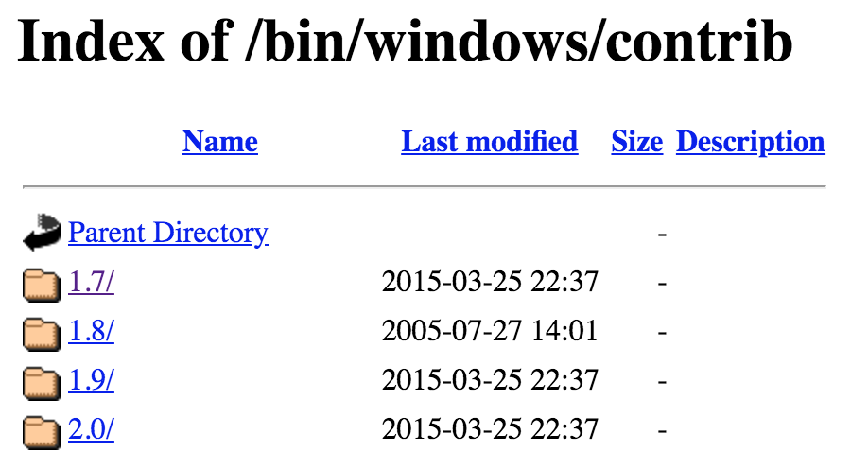
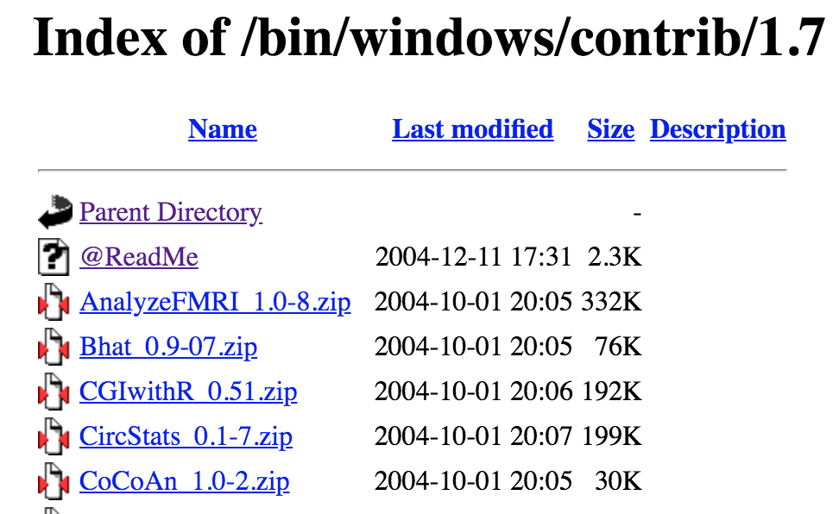
Step 5b: Older versions (Windows)
Only if necessary
Windows
Choose older version of R for your OS
Choose an older package of R to download

Slide 9
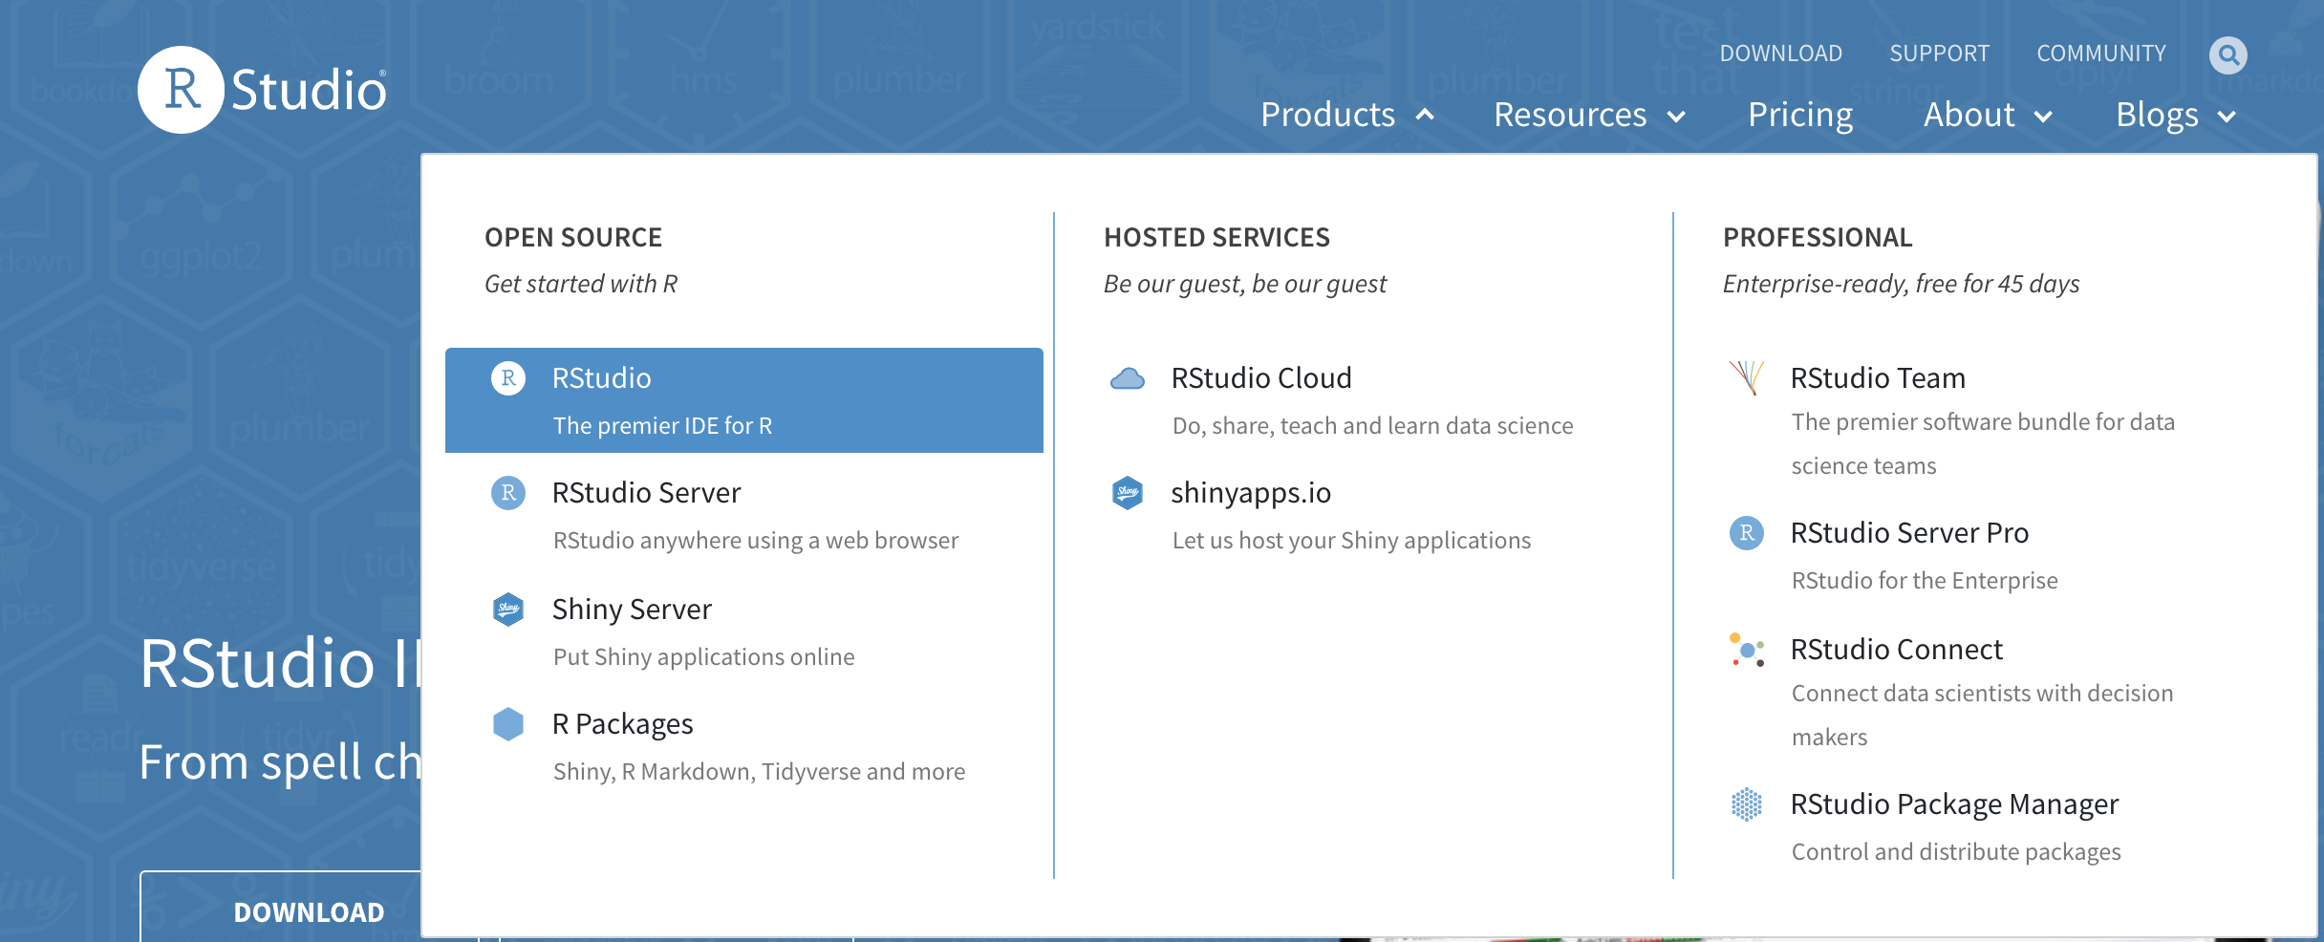
Step 6: Go to www.rstudio.com and click RStudio under Products

Slide 10
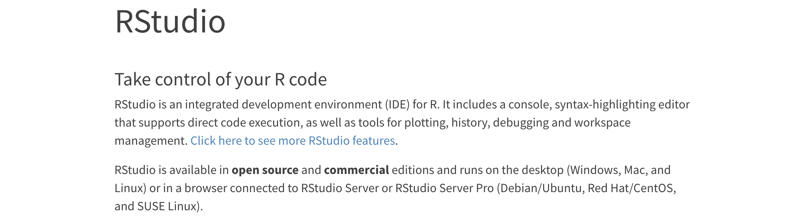
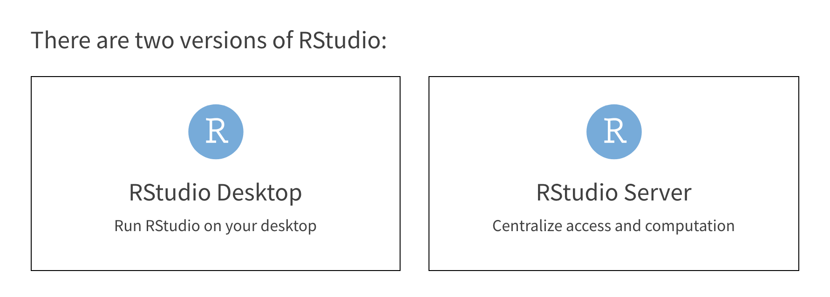
Step 7: Click RStudio Desktop

Slide 11
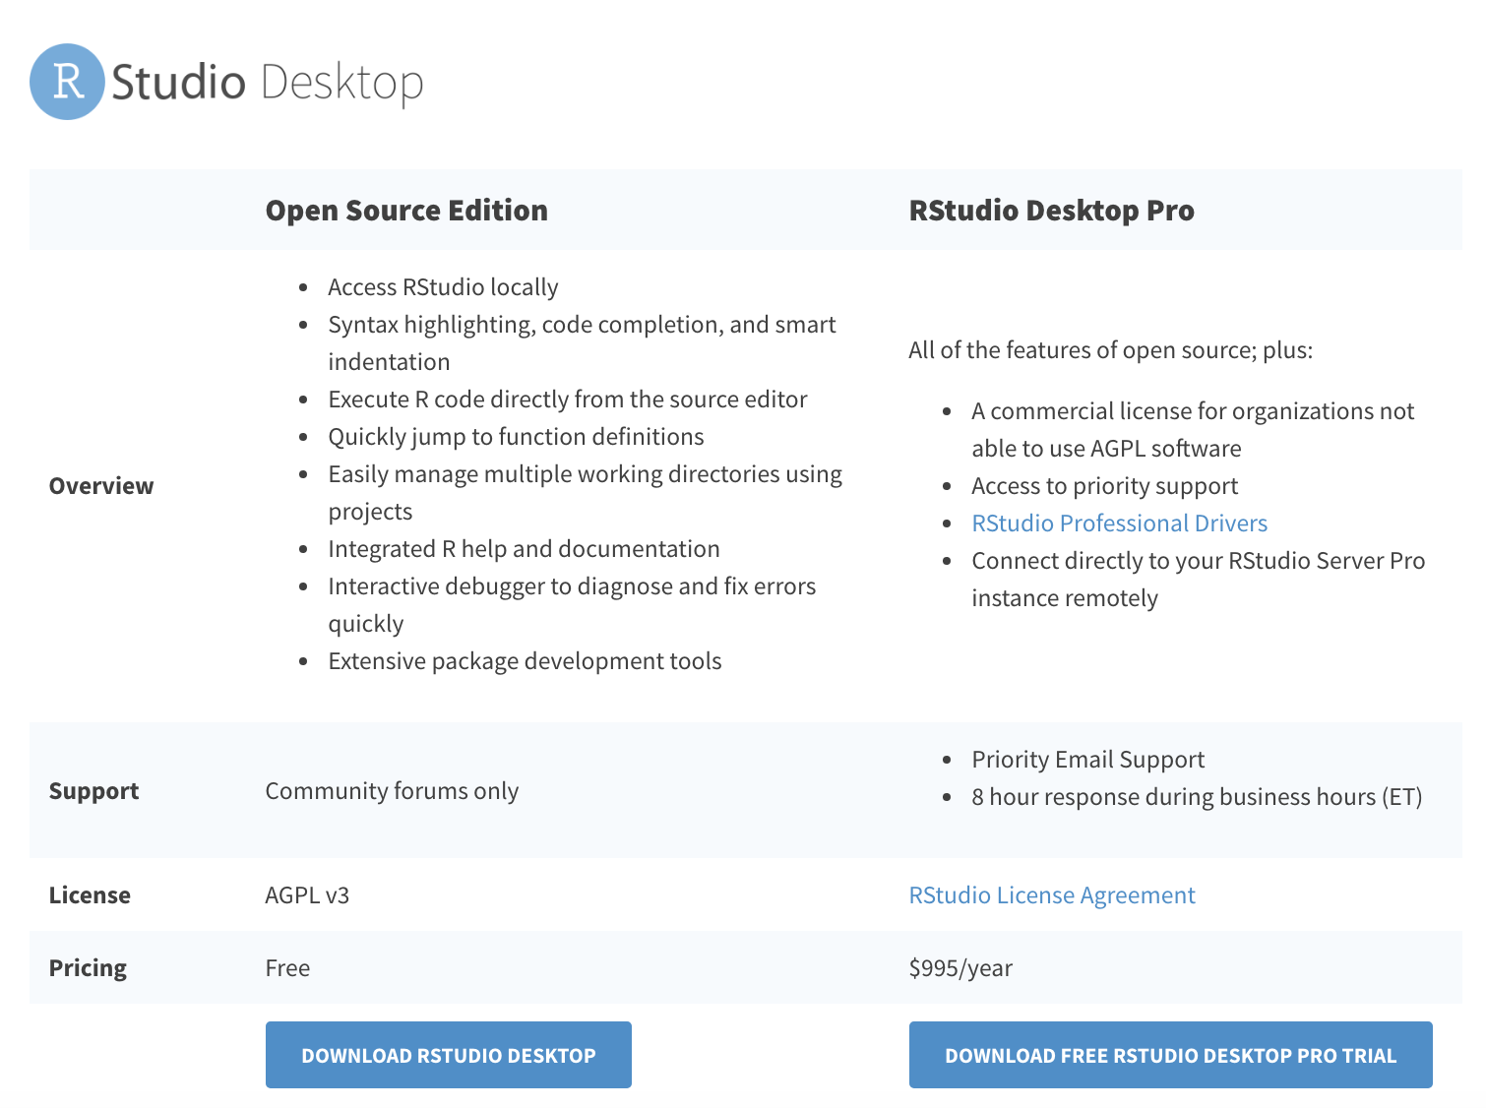
Step 8: Click Download RStudio Desktop

Slide 12
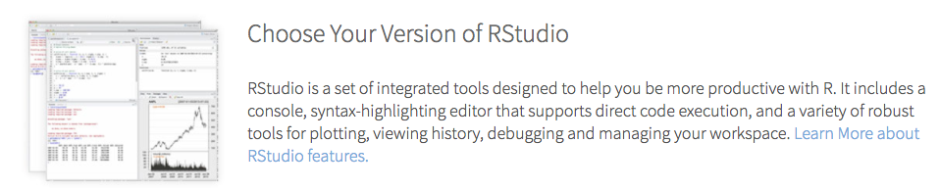
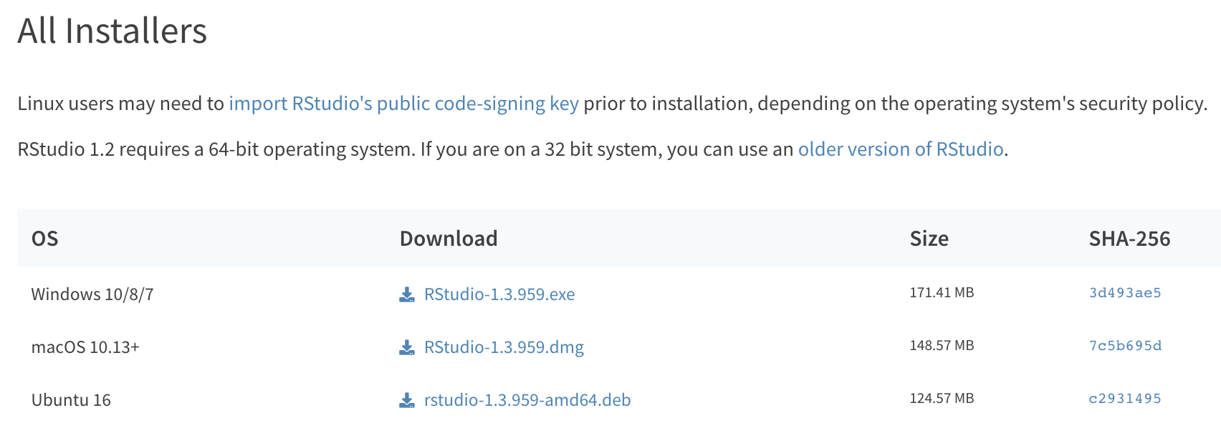
Step 9: Scroll down and click Rstudio package for your operating system

Slide 13
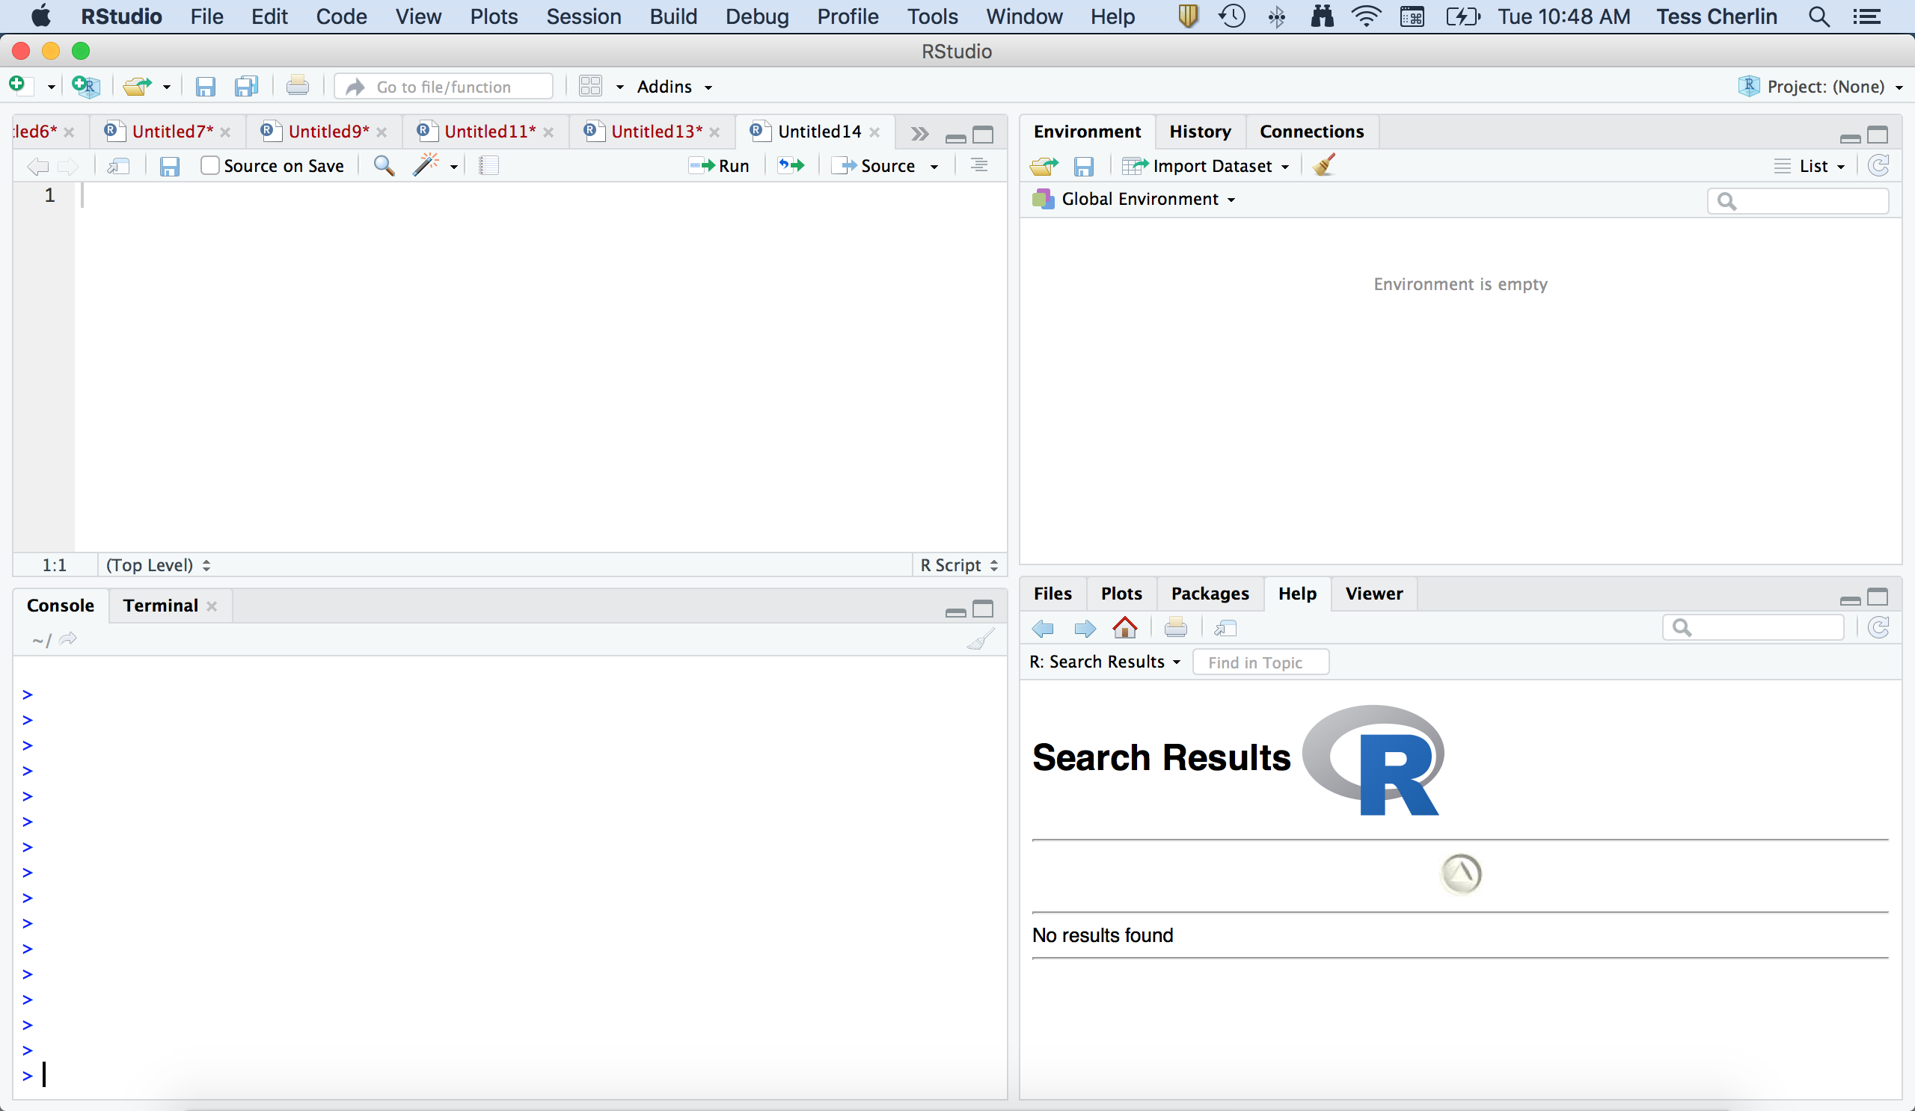
Step 10: Move RStudio to Applications Folder and open it… should look like this

Slide 14
Email tess.cherlin@jefferson.edu if you have any problems with this tutorial.

